Slide 1


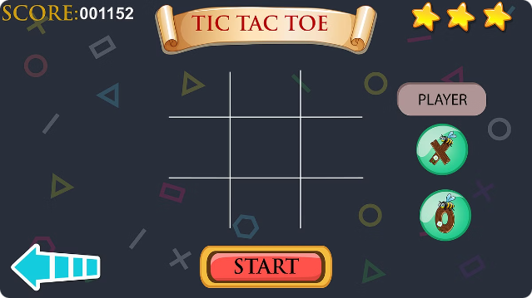
Tic-Tac-Toe Web Application
by VAIBHAVI SAHU
build an interactive tic-tac-toe game using HTML, CSS, and JavaScript. We'll create a game board, implement game logic, and even add an AI opponent
Tic-Tac-Toe is a classic game that has been enjoyed by people of all ages for generations. It is a simple game that requires two players to take turns marking Xs and Os on a 3x3 grid, with the objective of getting three in a row. The game is easy to learn but can become quite competitive once players start to master their strategies.

Slide 2

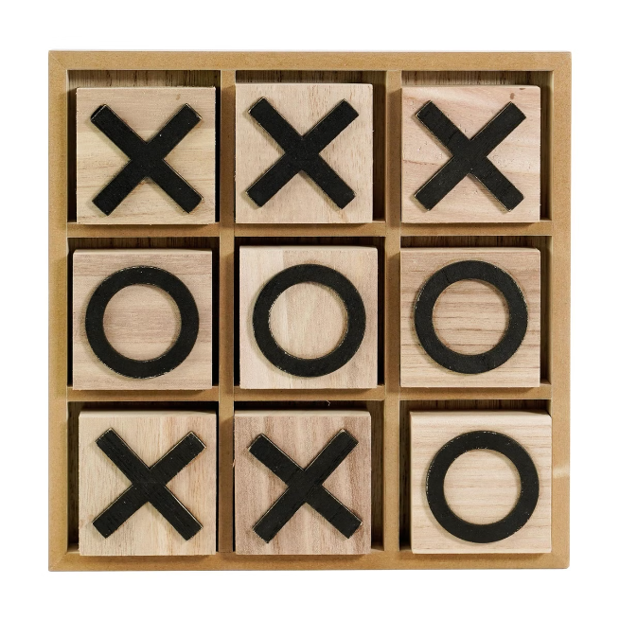
HTML Structure
Game Board
Use a table or a div with nine child elements to represent the game board's squares.
Player Turn Display
Display the current player's turn using a paragraph or heading element.
Game Status
Display messages like "Game Over" or "Player X Wins" using a paragraph or heading element.
Restart Button
Include a button to reset the game and start a new round.

Slide 3
<!DOCTYPE html>
<html lang="en">
<head>
<meta charset="UTF-8">
<meta http-equiv="X-UA-Compatible" content="IE=edge">
<meta name="viewport" content="width=device-width, initial-scale=1.0">
<title>Tic-Tac-Toe</title>
<link rel="stylesheet" href="style.css">
</head>
<body>
<div class="main">
<div class="players">
<div class="player">
<h2>Player 1</h2>
<div class="player__symbol">X</div>
</div>
<div class="player">
<h2>Player 2</h2>
<div class="player__symbol">O</div>
</div>
</div>
<div class="board-container">
<div class="board">
<button class="board__cell" data-cell-index="1"></button>
<button class="board__cell" data-cell-index="2"></button>
<button class="board__cell" data-cell-index="3"></button>
<button class="board__cell" data-cell-index="4"></button>
<button class="board__cell" data-cell-index="5"></button>
<button class="board__cell" data-cell-index="6"></button>
<button class="board__cell" data-cell-index="7"></button>
<button class="board__cell" data-cell-index="8"></button>
<button class="board__cell" data-cell-index="9"></button>
</div>
</div>
<button class="game-restart-btn">Restart Game</button>
<div class="popup hide">
<p id="message">Sample Message</p>
<button class="popup__restart-btn">New Game</button>
</div>
</div>
<script src="game.js"></script>
</body>
</html>

Slide 4

CSS Styling
Board Layout
Square Styling
Player Markers
Set the size and position of the game board using CSS properties like "width," "height," and "margin."
Style the individual squares with background colors, borders, and text styles to enhance visual appeal.
Choose different colors or symbols to represent player X and player O.

Slide 5
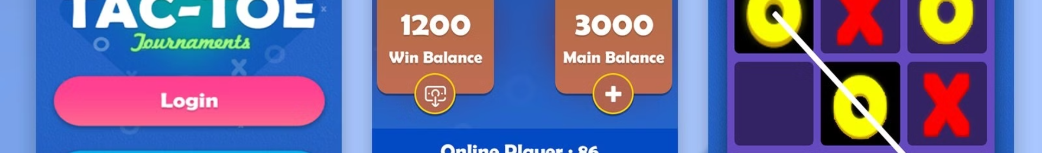




JavaScript Functionality
Event Listeners
Attach event listeners to the squares to detect user clicks.
Game Logic
Implement functions to handle turns, update the game state, and display player markers.
Winning Condition
Define functions to check for winning combinations across rows, columns, and diagonals.
Game Over
Display the winner or a tie message when the game ends.

Slide 6
//This function is executed when a player wins const winFunction = (letter) => { disableButtons(); if (letter == "X") { msgRef.innerHTML = "&#x1F389; <br> 'X' Wins"; } else { msgRef.innerHTML = "&#x1F389; <br> 'O' Wins"; } }; //Function for draw const drawFunction = () => { disableButtons(); msgRef.innerHTML = "&#x1F60E; <br> It's a Draw"; }; //New Game newgameBtn.addEventListener("click", () => { count = 0; enableButtons(); }); restartBtn.addEventListener("click", () => { count = 0; enableButtons(); }); //Win Logic const winChecker = () => { //Loop through all win patterns for (let i of winningPattern) { let [element1, element2, element3] = [ btnRef[i[0]].innerText, btnRef[i[1]].innerText, btnRef[i[2]].innerText, ]; //Check if elements are filled //If 3 empty elements are same and would give win as would if (element1 != "" && (element2 != "") & (element3 != "")) { if (element1 == element2 && element2 == element3) { //If all 3 buttons have same values then pass the value to winFunction winFunction(element1); } } } }; //Display X/O on click btnRef.forEach((element) => { element.addEventListener("click", () => { if (xTurn) { xTurn = false; //Display X element.innerText = "X"; element.disabled = true; } else { xTurn = true; //Display Y element.innerText = "O"; element.disabled = true; } //Increment count on each click count += 1; if (count == 9) { drawFunction(); } //Check for win on every click winChecker(); }); }); //Enable Buttons and disable popup on page load window.onload = enableButtons;

Slide 7
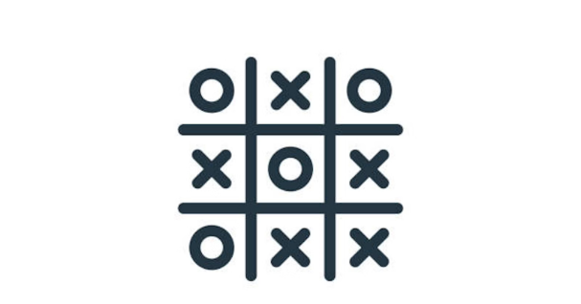
ADD INTRACTIVITY WITH JAVASCRIPT
In this code snippet, we can see a JavaScript implementation of a Tic Tac Toe game. The game is played on a 3x3 grid and players take turns marking their X or O on a square of the grid. The code uses event listeners to detect when the user clicks on a square and displays their X or O accordingly.
The code also has functions to check for a winning pattern and disable all the buttons when a player wins or when the game is a draw. When a player wins, the message is displayed with the winning player's symbol.
There are also two buttons, one to start a new game and another to restart the current game. The code uses a count variable to keep track of the number of moves played, and if no winning pattern is found and all squares are filled, the game is considered a draw

Slide 8

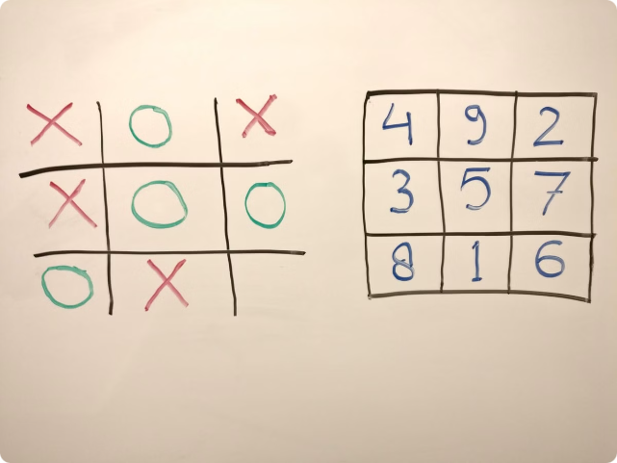
Handling User Clicks
1
Click Event
Use the "onclick" event handler to trigger a function when a square is clicked.
2
Check for Availability
Verify if the clicked square is empty before placing a marker.
3
Place Marker
Update the square's content with the current player's marker.
4
Switch Turns
Change the current player and update the turn display.

Slide 9

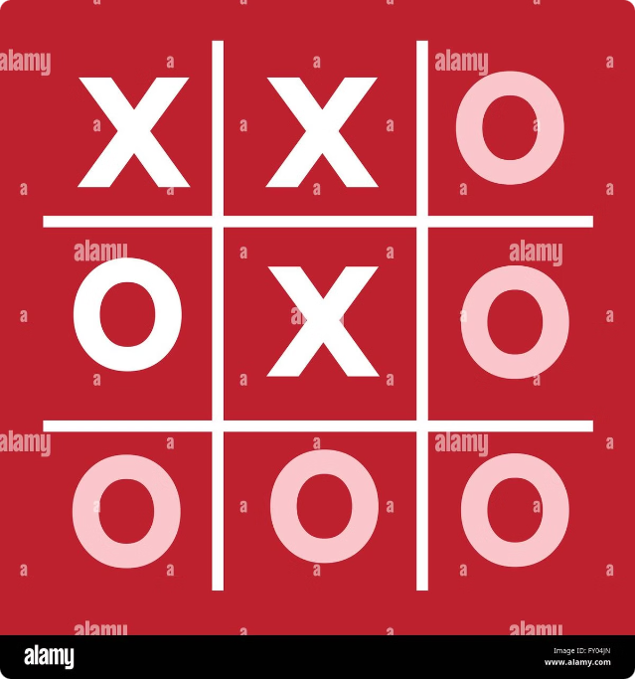
Tracking Game State
Board Array
Use an array to store the state of each square on the board, representing empty squares as null or an empty string.
Current Player
Maintain a variable to track the current player's turn, alternating between "X" and "O."
Game Over Flag
Set a flag to indicate whether the game has ended (true) or is still ongoing (false).

Slide 10


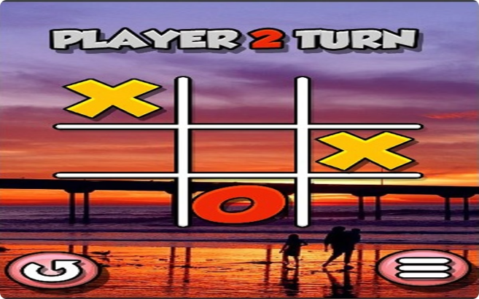


AI Opponent
Random Move
For a simple AI, implement a function to randomly select an available square.
Strategic Moves
For a more challenging AI, use algorithms to identify strategic moves that block the opponent or create winning opportunities.
Minimax Algorithm
Utilize the minimax algorithm to predict future moves and choose the optimal action for the AI.

Slide 11

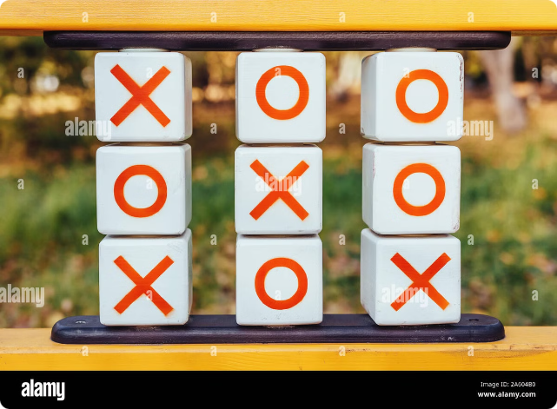
Game Over and Restart
1
Check for Winner
Implement a function to check if any winning combinations are present.
2
Display Result
Update the game status display to announce the winner or a tie.
3
Restart Button
Attach a click event to the restart button to reset the game state and clear the board.

